Slide 1

COMPOSITE STRUCTURE DIAGRAM
Presented By:
Mugdha Srivastava (E_ID: 6150)
Shiva Gillepally (E_ID: 6152)
Anudeep S (E_ID: 6148)
Amit Dash (E_ID: 6149)
Niharika Ramesh (E_ID: 6151)

Slide 2

CONTENT
Introduction
Purpose
Composite Structure Diagram at a Glance
Class diagram vs Composite structure diagram
Composite Structure Diagram Example
Conclusion

Slide 3

INTRODUCTION
What is Composite Structure Diagram?
Composite Structure Diagram is one of the new artifacts added to UML 2.0. A composite structure diagram is a UML structural diagram that contains classes, interfaces, packages, and their relationships, and that provides a logical view of all, or part of a software system. It shows the internal structure (including parts and connectors) of a structured classifier or collaboration.
A composite structure diagram is a UML structural diagram that provides a logical overview of all or part of a software system. It acts as a look inside a given structured classifier, defining its configuration classes, interfaces, packages, and the relationships between them at a micro-level.

Slide 4


PURPOSE
Composite Structure Diagrams allow the users to "Peek Inside" an object to see exactly what it is composed of .
The internal actions of a class, including the relationships of nested classes, can be detailed.
Objects are shown to be defined as a composition of other classified objects.

Slide 5
CLASS DIAGRAM VS COMPOSITE STRUCTURE DIAGRAM
As UML diagrams, both composite structure diagrams and class diagrams are used to visualize and organize the actors, interactions, and artifacts within a system. But while composite structure diagrams and class diagrams have similar meanings, they are ultimately different in how they express those meanings. Simply put, composite structure diagrams are more specific and less ambiguous than class diagrams .
A composite structure diagram allows users to more clearly model the implementations of an artifact’s activity within a runtime. They’re also more adept in depicting decomposition in context, describing the internal structure of multiple classes and the set relationships between them. Simply put, if you’d like to convey concrete, explicit information about the behaviors and relationships within your system, a composite structure diagram is your best choice.
A composite structure diagram is similar to a class diagram, but it depicts individual parts instead of whole classes. Before you can define the internal structure of a classifier, you must either show its structure compartment or open a composite structure diagram. You can then model the parts that represent the instances that the containing classifier owns. You can add connectors to link two or more parts in an association or dependency relationship.

Slide 6
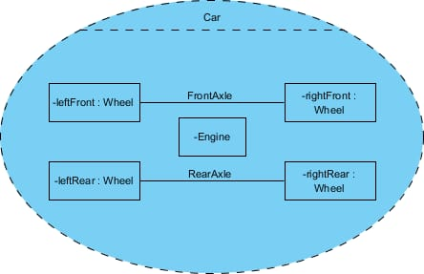
Composite Structure Diagram at a Glance
Composite Structure Diagrams show the internal parts of a class.
Parts are named:
partName : partType [multiplicity]
Aggregated classes are parts of a class but parts are not necessarily classes, a part is any element that is used to make up the containing class.

Slide 7

Composite Structure Diagram Example
Let's develop the composite structure diagram for a computer system which include the following a list of the components:
Power Supply Unit (PSU)
Hard Disk Drive (HDD)
Mainboard (MB)
Optical Drive (DVD-RW)
Memory Module (MM)

Slide 8

CONCLUSION
composite structure diagrams are useful for showing the internal structure of a system or piece of software. However, its usefulness lies in its ability to show functionality and collaboration. Using this, you can study the collaboration of various elements, and can use this information to troubleshoot parts of a system.

Slide 9


